Slide 1
APP: Assessment of Physiotherapy Practice Instrument Physiotherapy Clinical Educator Training

Slide 2
Learning objectives
By the end of this presentation you will:
Understand the components of the APP
Be able to use the APP instrument effectively in formative feedback and summative assessment
Feel more comfortable in your role as assessor of students

Slide 3
APP development and use
Currently used by all Australian Physiotherapy Programs for assessment of student performance on clinical placements
All graduates must meet same competencies/standards outlined in Australian Standards for Physiotherapy
Clinical educators dealing with multiple programs want one form that had evidence of validity and reliability
APP developed and tested across 5 years with involvement of educators, managers, students and universities

Slide 4
The ‘Roles’ of Assessment – what does workplace based assessment do for students?

Slide 5
Role of assessment
Directs students to knowledge skills & attitudes they are performing well & those requiring improvement (the ‘formative’ role of assessment)
Forms basis for development of strategies to change performance
Tells students if they are meeting the standards – grades, … (the ‘summative’ role of assessment)
Notes:
Feedback and assessment are the key components driving learning and facilitating change in performance.

Slide 6
The APP (Assessment of Physiotherapy Practice) Instrument

Slide 7
APP- Assessment Instrument
Standardised instrument used nationally
Valid and reliable instrument
Identifies 7 domains of practice and lists 20 items considered fundamental to our profession
Scores are determined by a rating scale used in conjunction with performance indicators
APP is for use in ‘core’ clinical units where student is meant to carry their own caseload
Notes:
‘Core’ units mean those units usually in the second last and final year of a student’s program where the student is expected to carry their own caseload. The APP presented here is not appropriate for use with introductory professional practice placements as the behavioural expectations are not aligned to these units.

Slide 8
APP – paper based & online
APP is available in paper form or online
www.APPLinkup.com is the link to the online interactive assessment system
You can use either format, the guidelines are the same
Notes:
If your students present with paper based version for you to use, contact their University and ask about using the online version.

Slide 9
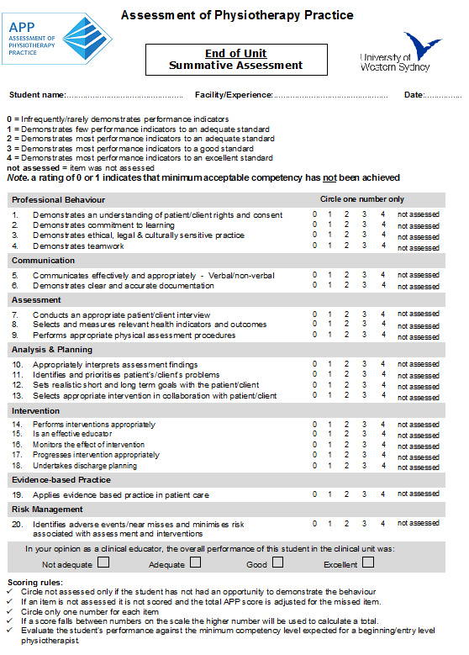
7 domains of practice
5 point rating scale to rate each item
20 items
Global rating scale
Scoring rules
Notes:
Paper-based version of the APP instrument

Slide 10
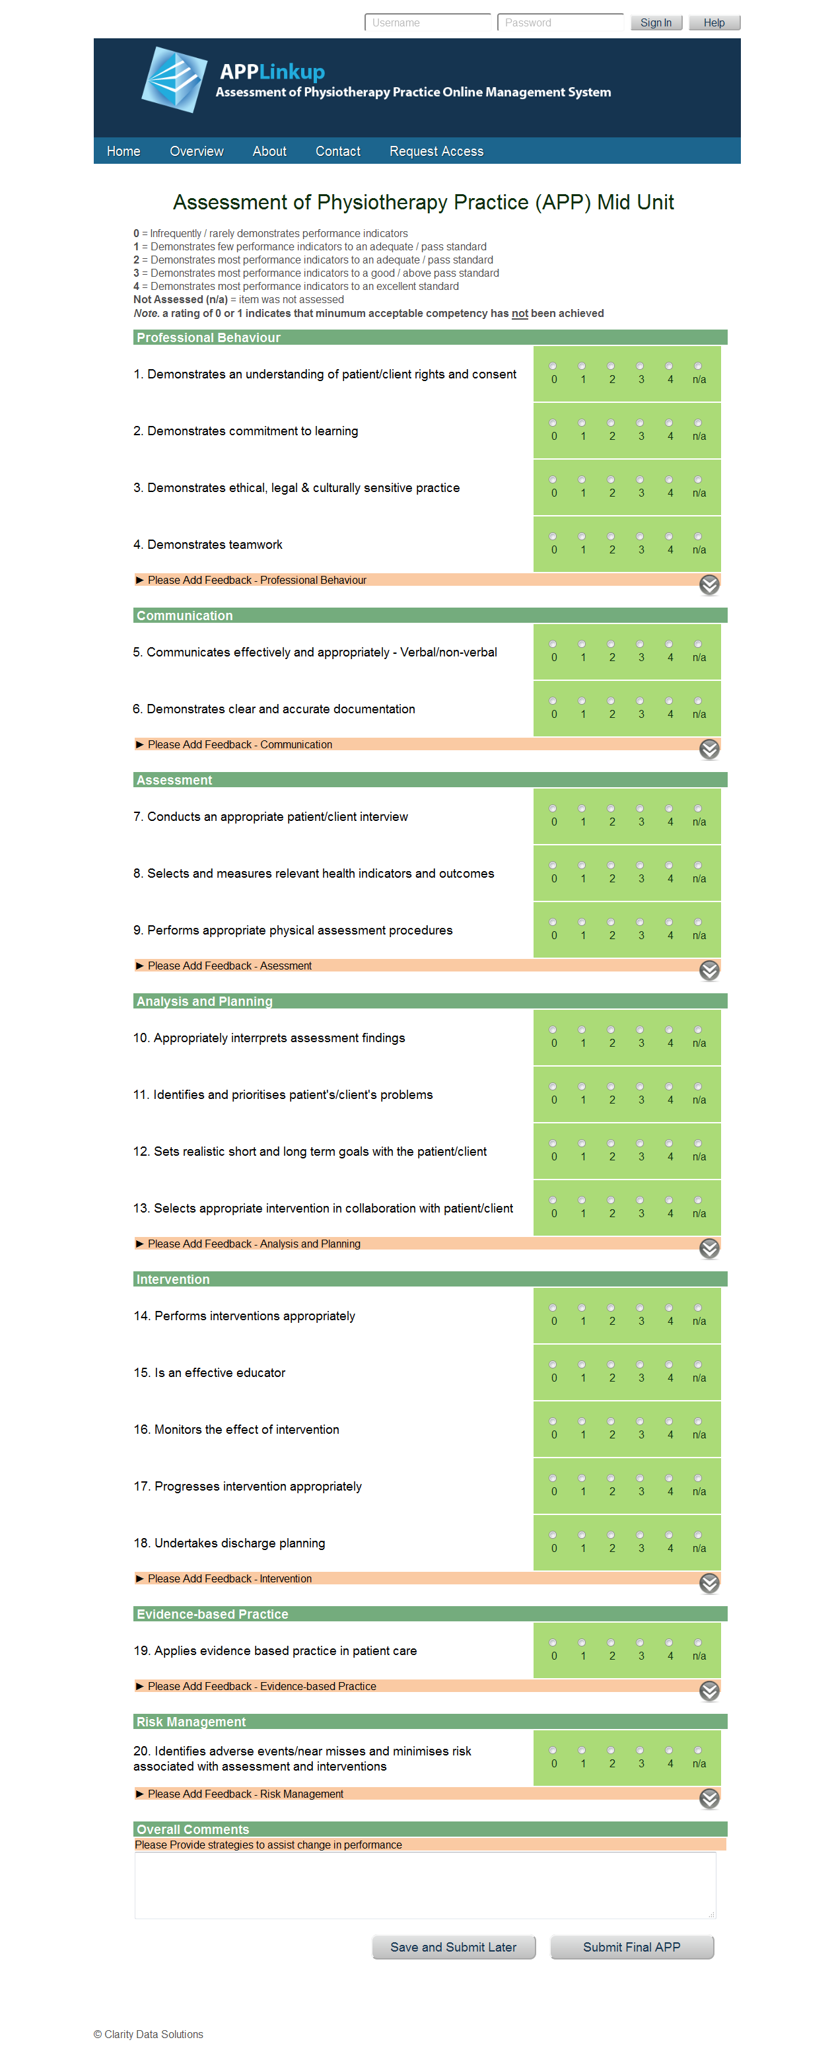
5 point rating scale to rate each item
7 domains of practice
Performance indicators in drop down menu
20 items
Notes:
Screen shot of the online version of the APP form

Slide 11
Performance Indicators
For each item
List of observable and concrete behaviours
Can guide feedback and grading for each item
Examples of evidence of competence (or lack of)
Designed to guide both students and educators
Are not an exhaustive list of possible behaviours nor are they to be used as a checklist when assessing a student’s performance

Slide 13
Global Rating Scale (GRS)
In your opinion as a clinical educator, the overall performance of this student in the clinical unit was:
Not adequate  Adequate  Good  Excellent
Complete only at summative assessment (Final)
Complete after rating all 20 items
Typically, this student demonstrates most items at an .……..level
Notes:
As the CE ask yourself the following question: “Typically this student demonstrates most items at ……. level”. This helps to decide on the overall global rating of student performance.

Slide 14
Global rating scale
Captures complexity of expert performance
Most reliable measure of clinical skill that is also sensitive to increasing levels of expertise.
Better measure of complex interactions such as communication, rapport etc.
Assists identification of borderline students
There is evidence that a combination of global scores and items are complimentary methods

Slide 15
How to complete the APP: using the rating scale

Slide 16
Scoring the APP
Scoring is based on direct observation and interpretation of student performance.
Circle the rating from 0 – 4 that best represents your judgement of the student’s level of performance at the end of the unit

Slide 17
Scoring the APP
Use Not Assessed only if student has not had an opportunity to demonstrate the behaviour
Circle only one number for each item
Complete the global rating scale at the end of unit

Slide 18
In the APP the final rating for each item quantifies the level of performance achieved relative to that of
beginning practitioner standards of practice
0 1 2 3 4 N/A
This is the passing standard
Notes:
A rating of a 2 means the student is achieving the minimum acceptable entry level /beginning practitioner standard of performance

Slide 19
APP – scoring
0 1 2 3 4 N/A
0 & 1 = not achieving the minimum acceptable entry level standard of performance
2 = minimum acceptable standard
3 & 4 = indicating good and excellent performance
N/A: not assessed

Slide 20
Why choose entry level/minimally competent as passing standard?
Enables ranking of students relative to a common standard.
May be the only time student experiences a particular clinical area
Better standardisation between assessors
Time based passing standard (where student is at in their program) is unpredictable, unacceptable & not transparent
Allows more targeted discussion, training
More effective in driving learning in students
Notes:
The results from focus group discussions about entry level/beginning physiotherapist standards have demonstrated a clear consensus from clinical educators regarding a global definition of minimally competent performance

Slide 21
So what does a student who is performing at a minimally competent, passing standard look like?

Slide 22
Entry Level Description – Passing standard
Take a few minutes and write down phrases to complete this sentence
A student is performing at the entry level/minimally competent standard when they ……..

Slide 23
Passing Standard/Entry Level Description
Adequate assessment
Adequately communicate, patient understands
Formulate treatment plan
Safe, to independently manage a patient
Ability to think and reflect, self evaluate
Willingness to learn and take on feedback
teachable, safe, responsive, adequate, appropriate
Notes:
This is a summary of words/phrases that other groups of physiotherapists have generated when answering the question on the previous slide.

Slide 24
Passing Standard/Entry Level Description
Employable
Able to carry a case load of basic patients with some supervision
Measure their own outcomes
Maintain safety
Write notes legibly, accurately
work independently and with a team
Ask questions know their limitations

Slide 25
Entry Level – typically a student would
0
demonstrate an understanding of patient centered physiotherapy practice and are able to manage a variety of patients such that the major problems are identified, goals established and intervention is completed safely, professionally, effectively within in a reasonable time frame.
While achieving this, the student is aware of their limitations and where to seek assistance.
Notes:
25
This is the APC guideline definition

Slide 26
Entry Level
Remember entry-level is the minimum demonstrated behaviour required for entry to the physiotherapy profession
……….not a measure of capacity to undertake specific workplace duties without any assistance/support
Notes:
Think about how any new physiotherapist requires on the job training and additional assistance when they start work at a new health facility.

Slide 27
Higher level standard
Remember a number of students achieve better than minimum standard………
…..this does not mean we should elevate our concept of entry level

Slide 28
When to use the APP

Slide 29
When to use the APP instrument?
Begin early
Day 1 of the unit; end of week 1 (set expectations and learning objectives with student using APP)
Mid-placement (formative feedback – use performance indicators to give evidence of strengths and weaknesses)
End of placement (summative assessment of items and global rating scale)

Slide 30
Mid unit – formative feedback
What will you do?

Slide 31
Mid unit formative feedback
Use the APP items & performance indicators to discuss with student areas of strength and for improvement
Student and educator both input into mid unit assessment
Score the APP items only if you have enough evidence
Provide specific examples of behaviour
If you have items not assessed, need to view these before the end of unit

Slide 32
Mid unit formative feedback
A score of 0 would be a matter of immediate importance
Notify the university
A score of 1 for any item – warrants feedback and strategies to assist student to achieve a passing standard for the item

Slide 33
APP instrument
Student & CE
Begin early
Student
Mid unit feedback using the APP

Slide 34
End of unit – summative assessment
What will you do?

Slide 35
Summative Assessment
Process
Refer to APP Clinical Educator Resource manual for detailed explanation on use of instrument.
Read the performance indicators within each aspect of practice
Determine the appropriate score using the rating scale for each item
Record the score(0-4) against each item
Complete the global rating scale
Refer to scoring rules
Notes:
Refer to the Examples of Performance Indicators for behaviours that the student may demonstrate to indicate competency in a particular item
The Examples of Performance Indicators are not an exhaustive list of possible behaviours nor are they to be used as a checklist when assessing a student’s performance.

Slide 36
Summative Assessment
After completing the APP
identify trends (strengths/ weaknesses)
Considers strategies for the student to progress in next unit
Complete any additional pages of assessment documents (feedback, summaries etc)
If any item is scored <2 in (final assessment) contact Uni to discuss prior to meeting with student.
A student can still pass with a 2-3 items rated as a 1 but if more than this then really consider failing the student as they most likely need more time.
Prepare for formal feedback session with student and discuss the outcome with them
Sign documents and return to University
Notes:
Assessment should be determined prior to feedback session NOT negotiated
Strategies may be recorded during the feedback session as agreed/discussed with student
give students a copy of documentation and feedback

Slide 37
Summary: advantages of APP
Reliable and valid instrument
Led to reduction in burden on clinical educators
Standardisation of assessment processes between universities
Improved training of educators, reduction in duplication
Opportunities to continue evaluation and refinement of APP and assessment approaches

